Slide 1
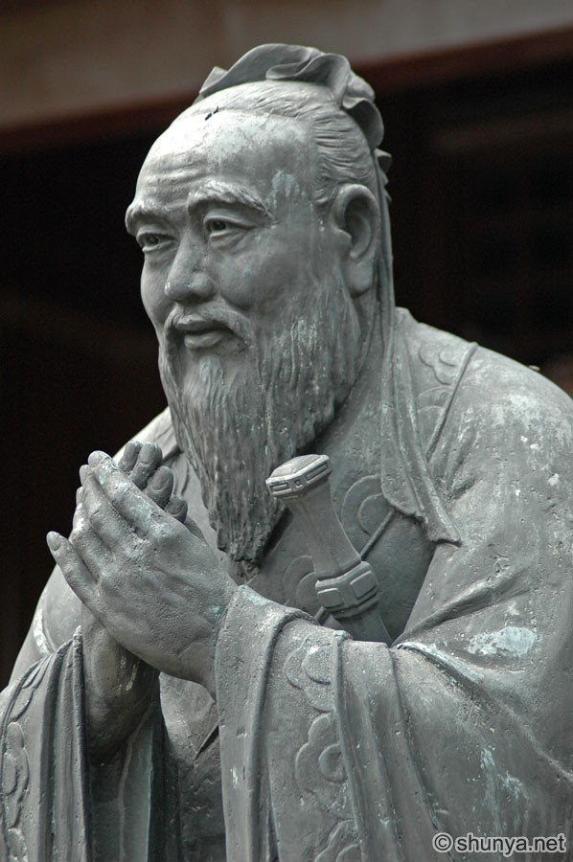
Confucian echoes? Aristotle and Confucius
550-470 BC
Politics of moral excellence (virtue)
- led by those of virtue
- aims to engender virtue by example
Excellence cultivated by
Ritual and right practice
Filial piety and loyalty

Slide 2
Shared themes (Sim, 2007)
Humanistic approach. Political philosophy rests on ethics.
Virtue based ethics – basis in habits and practices. Not rule-based, rather a cultivated disposition to choose a ‘mean’ in actions. Political leadership should be rooted in virtue. Meritocracy based on virtue / moral excellence.
Justice is governing for the common advantage .
Harmony from each playing its natural role in the whole.
The aim of governance is the development of virtue in the governed. Education is emphasised.
Family is hierarchical in structure and important in the exercise of virtues.

Slide 3
Divergence (Sim 2007)
Confucius
Aristotle
Public / private separation: polis governed as by a ‘statesman’ (relative equality).
Laws are important and work alongside virtue to create a good society.
Multi-level pragmatic analysis of constitutions, adapted to cultures and circumstances. Not all circumstances will be suited to support ideal forms.
No public/private split. Polis an extension of familial ties. Both hierarchical.
Laws do not work and undermine virtue as they encourage superficial compliance/avoidance of punishment and ‘no shame.’ Better to lead by virtuous example.
Focus on benevolent rule by a ‘sage/king.’

